Slide 1
BUAN 6356 Project Report
Term Project Report - GROUP 13

Slide 2
Predicting the Revenue of Movies using IMDb data
MIS 6356.004- Group 13:
Durvesh Golvankar
Suraj Arvind Mhetre
Priyank Mukund Shinde
B. R. Keerthi

Slide 3
Overview of Project
We will use the variables from “IMDB 5000 movies dataset” to analyze how important they can be to predict the movie’s IMDb rating.
This prediction will help production houses and filmmakers to see what the recipe is for getting higher ratings.
This will also help them understand where they should invest for these higher ratings to be successful at the box office and to build a brand for their respective production houses.

Slide 4
Course Of Action
Data cleaning and pre-processing
Data Visualization
Data Modeling
Various steps to be followed along the project

Slide 5
Business Understanding
Industry – Film or motion picture production
Firm Name – Warner Bros.

Slide 6
Movie Production Industry Analysis
Necessity for Analysis :
Challenges like :
The amount of box office ticket sales in 2011 was lower than 1995 ticket sales. http://www.the-numbers.com/market/ Some reasons listed recently in the press include;
pressure from players like Netflix
less than interesting movie scripts and plots
pay per view
Thus we use Porter’s Five Forces Framework to analyze the industry.

Slide 7
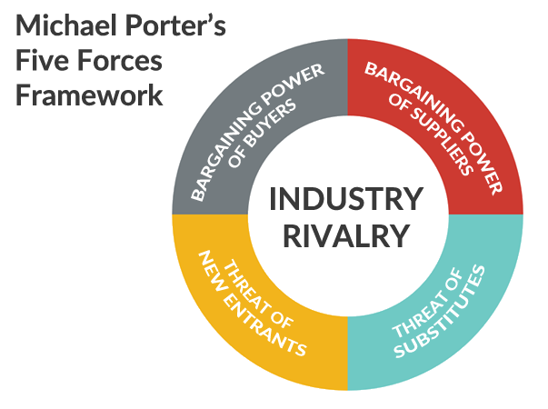
Porter’s Five Forces Framework
In his revolutionary article - "Five Forces that Shape Strategy", Michael Porter observed five forces that have significant impact on a firm's profitability in its industry. These five forces analysis today in business world is also known as -Porter Five Forces Analysis. The Porter Five (5) Forces are -
Threat of New Entrants
Bargaining Power of Suppliers
Bargaining Power of Buyers
Threat from Substitute Products
Rivalry among the existing players.

Slide 8

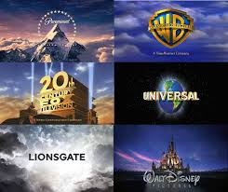
1. Threat of New Entrants

Slide 9
Threat of New Entrants…Prior to the current digital age, there was little threat to the movie making industry. There were a handful of powerful studios who for the most part dictated who was allowed to participate and who was not. The cost of Movie Stars, sets, payrolls, equipment and the risk of loss, combined with the fickle tastes of a theater going public made the industry a large risk. To offset that risk, a large expense was required to generate success in the first few weeks of the movie’s release in the form of advertising. Therefore, it took large pools of capital and many investors to spread out the risk. Making this a high barrier to entry.
Today…There are more low budget and independent movies finding acceptance among a larger audience. The reason? The long tail generated by the internet. Many examples of lower budget films achieving success in profits versus box office receipts exist.
http://www.the-numbers.com/movies/records/budgets.php
These examples are due to reasons beyond a good story line. It’s because the scope of information we as individuals can take in has broadened. The internet allows us to seek out avenues of entertainment beyond the mainstream movie. Anyone with a good story, willing actors and a creative entrepreneurial talent can make a movie, and use a social media campaign. The definition of the movie going industry is widening its boundaries to entertainment and the industry finds itself competing against new entrants with lower barriers of entry.

Slide 10
2. Bargaining power of buyers
Bargaining power of buyers is immense as there are no switching costs for the customers of Warner Bros.
Buyer bargaining power is also fuelled by abundance of offers in films and manufacturing industry.

Slide 11
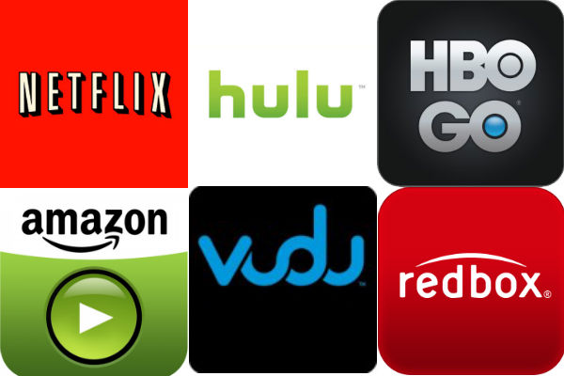
1. Threat of Substitute Products

Slide 12
Threat of substitute products for movies are immense in the current era as there are variety of formats in videos now due to the rise of internet.
For instance, there are television shows which span across several seasons in contrast to movies that last for 3 hours on average.
Rise of streaming services has Lead to mushrooming of various formats of videos which compete on the same ground as movies.

Slide 13
4. Bargaining power of suppliers
Bargaining power of suppliers is greater in films and entertainment industry compared to many other industries. Due to the unique nature of this industry famous actors can be classified as suppliers at the same time as serving as human resources
According to this approach, the success of sequels of famous Warner Bros. franchises such as Lord of the Rings, Batman, Harry Potter and Hangover is possible only through attracting A-list actors and actresses who have great bargaining power.

Slide 14
5. Rivalry among existing competitors
Rivalry among existing competitors in global entertainment industry is intense and major companies competing in the industry along with Warner Bros. include Paramount Pictures Corporation, The Walt Disney Studios, Fox Filmed Industries and others.

Slide 15

Warner Bros. Overview

Slide 16
Warner Bros. Entertainment Inc. is a fully integrated, broad-based entertainment company and a global leader in the creation, production, distribution, licensing and marketing of all forms of entertainment and their related businesses.
The company’s vast library, one of the most prestigious and valuable in the world, consists of more than 100,000 hours of programming, 8,600 feature films and 5,000 television programs comprised of tens of thousands of individual episodes.
Warner Bros. Entertainment’s employee population ranges from 5,000 to 10,000 on any given day in North America (depending on the level of television and movie production) and some 2,000 employees overseas.

Slide 17
In 2018, Warner Bros. Pictures Group celebrated its best year ever with over $5.57 billion in worldwide receipts ($1.95 billion domestic, $3.62 billion international), marking the ninth time the Studio crossed the $4 billion mark.
Warner Bros. Home Entertainment was also the industry’s leader for the 18th consecutive year with an overall 18 percent market share.
Warner Bros. Pictures Group produces and distributes a wide-ranging slate of some 18-22 films each year, employing a business paradigm that mitigates risk while maximizing productivity and capital.
Warner Bros. Pictures is also a global leader in the marketing and distribution of feature films, operating offices in more than 30 countries and releasing films in over 120 international territories, either directly to theatres or in conjunction with partner companies and co-ventures.
New Line Cinema, part of Warner Bros. Entertainment since 2008, coordinates its development, production, marketing, distribution and business affairs activities with Warner Bros. Pictures to maximize film performance and operating efficiencies.

Slide 18
The Warner Bros. Television Group oversees and grows the entire portfolio of Warner Bros.’ television businesses, including worldwide production, traditional and digital distribution, and broadcasting.
Warner Bros. Animation is one of the leading producers of animation in the entertainment industry, with an innovative and talent-rich roster boasting some of the most accomplished writers, producers and artists working today.
Warner Bros. Home Entertainment brings together Warner Bros. Entertainment’s home video (Warner Home Video) and video games (Warner Bros. Interactive Entertainment) businesses in order to maximize current and next-generation distribution scenarios.
Founded in 2016, Warner Bros. Digital Networks is the fast-paced, growing team responsible for building and operating the Studio’s digital entertainment offerings, producing digital native content and harnessing the power of social media through Machinima.

Slide 19
Warner Bros. SWOT Analysis

Slide 20
1. Strengths
1. Strong financial position which is steady and growing 2. Rich knowledge and experience with history of production of these successful franchises 3. The agreement with Netflix Inc. that allows the viewer to stream previous sessions of shows’ series shown on CW network potentials for profit maximization.
4. Strong legacy since 1923
5. Over 8000 people are employed with the brand
6. Globally acclaimed media company producing movies, TV shows, entertainment etc
7. Recognized by several global awards
8. Producer of some of the biggest Hollywood blockbuster
9.Top of the mind movie production house

Slide 21
2. Weaknesses
1. Being a market leader, often criticized for trivial issues which become huge
2. Industry is very volatile as success of movies is never guaranteed

Slide 22
3. Opportunities
Introducing new instalments to its successful franchises such as The Lord of the Rings, Batman, Harry Potter and Hangover.
Expansion of digital distribution capabilities represents opportunity for Warner Bros. to strengthen its role as a leader of technological changes in the industry
Revenues can be further increased through higher integration of product placement marketing strategy.

Slide 23
4. Threats
Decline of the sales of DVDs due to the maturation of DVD format of entertainment challenging economic conditions, and piracy.
Declining popularity of US television programs
Increasing levels of operational costs
Increasing piracy

Slide 24
5. Competitors
Below are the 4 main Warner Bros. competitors :
Paramount Pictures
Walt Disney
Newscorp
Viacom

Slide 25
The Dataset : IMDB 5000 Movies
It contains 28 variables for 5043 movies, spanning across 100 years in 66 countries. There are 2399 unique director names, and thousands of actors/actresses. “imdb_score” is the response variable while the other 27 variables are possible predictors.

Slide 26
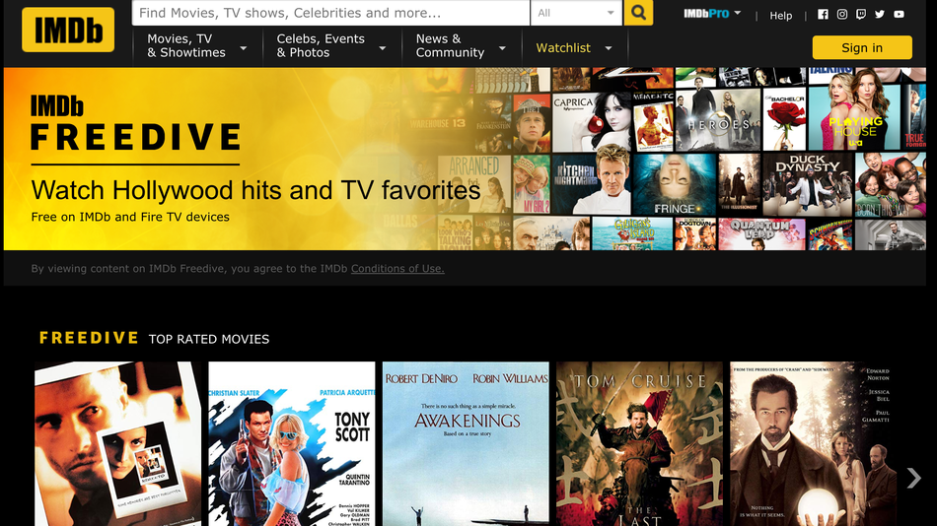

Slide 27
Data Analysis and Understanding
Period of time covered – 1916 - 2016
Number of records – 5024
Target variable to predict - imdb_score
Dataset link –
https://data.world/data-society/imdb-5000-movie-dataset

Slide 28
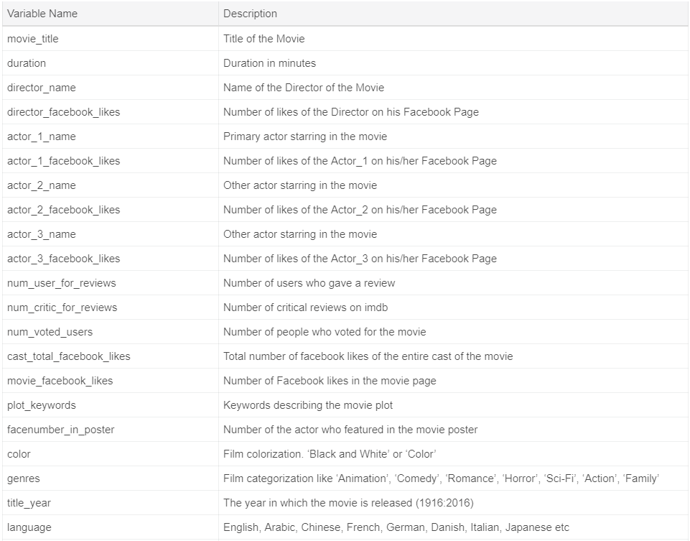
Data Analysis and Understanding
Description of all fields in the dataset –

Slide 29
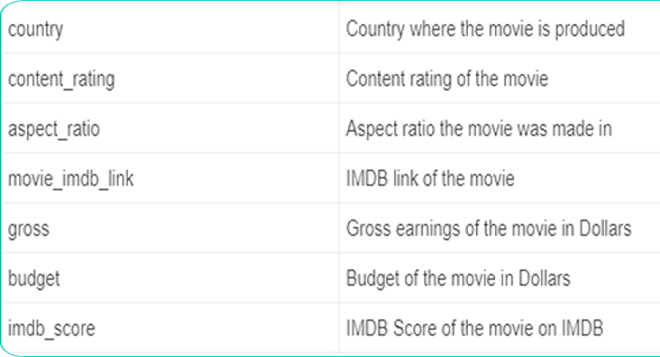
Data Analysis and Understanding
Description of all fields in the dataset(continue) –

Slide 30
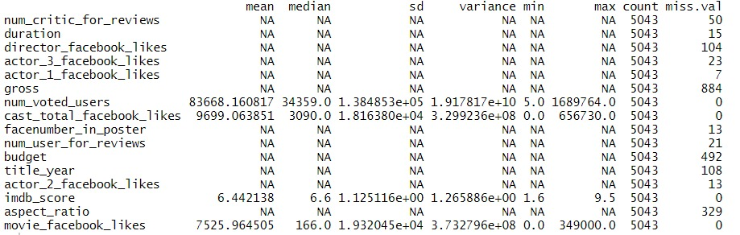
Summary of the Dataset : Descriptive Statistics

Slide 31
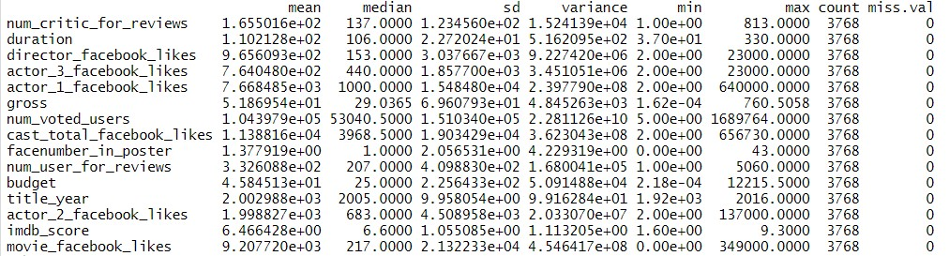
Descriptive Statistics after cleaning the data

Slide 32
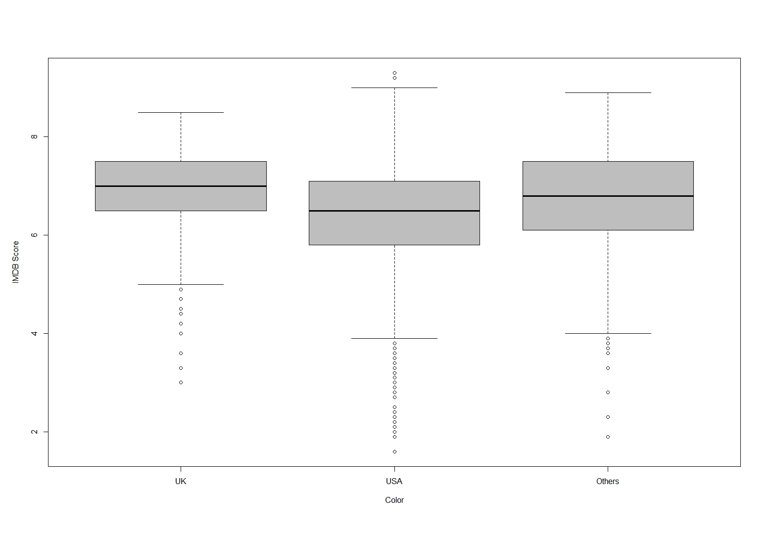
Box Plot of IMDB score vs country

Slide 33
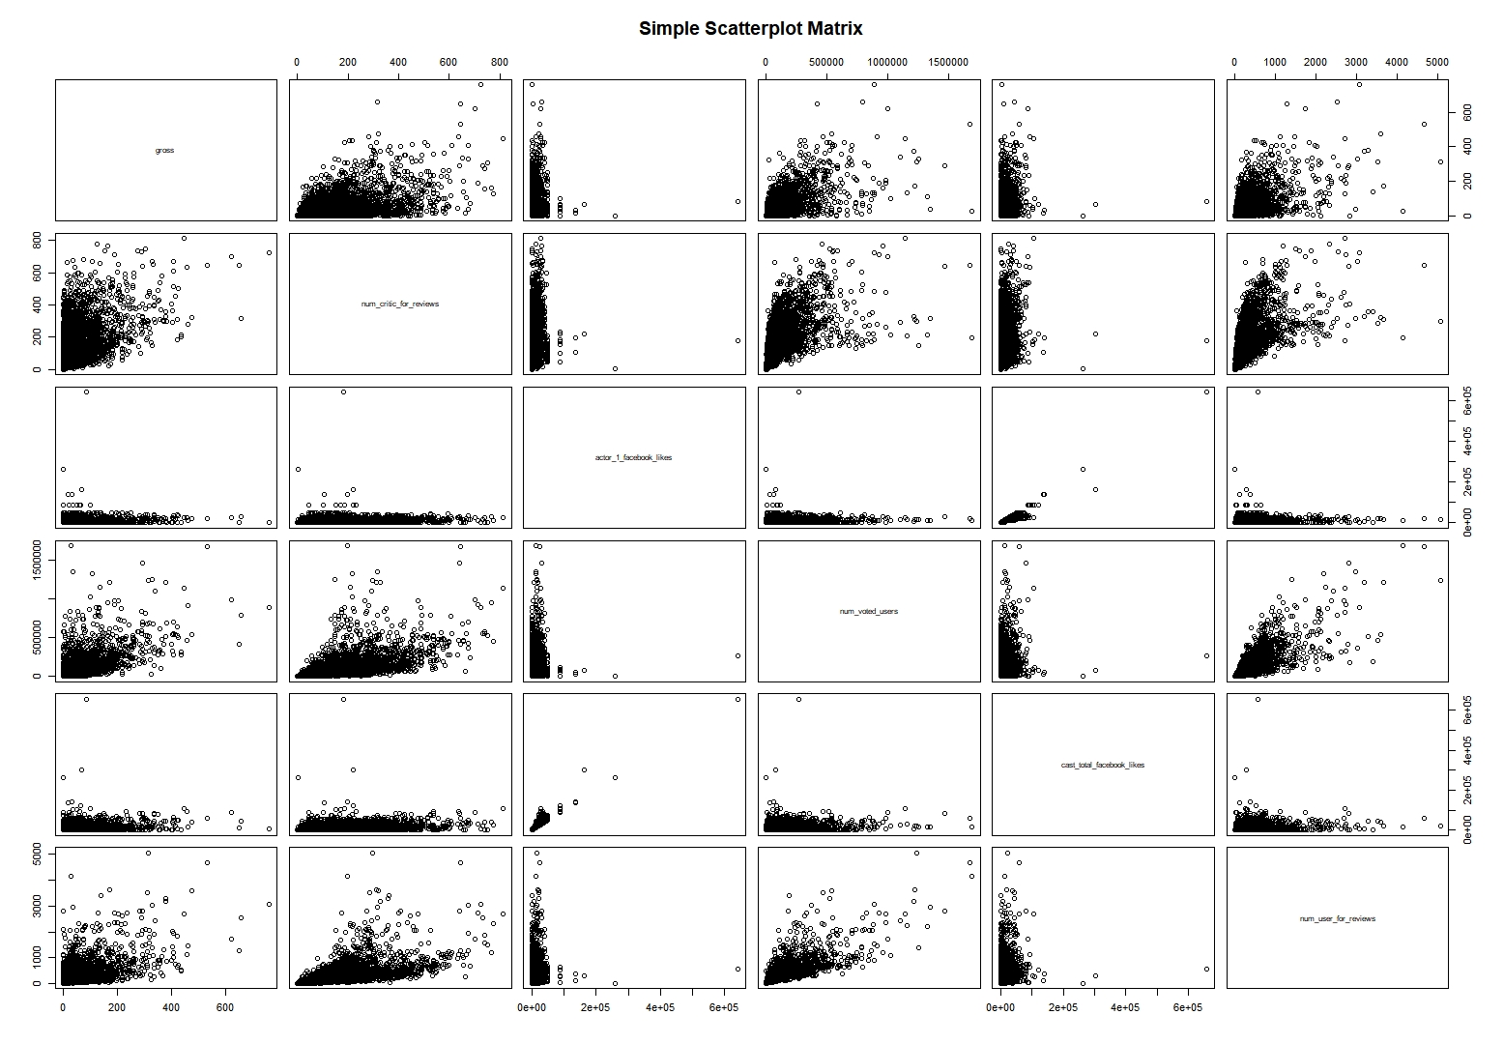
Scatter plot matrix

Slide 34
Bar Plot

Slide 35
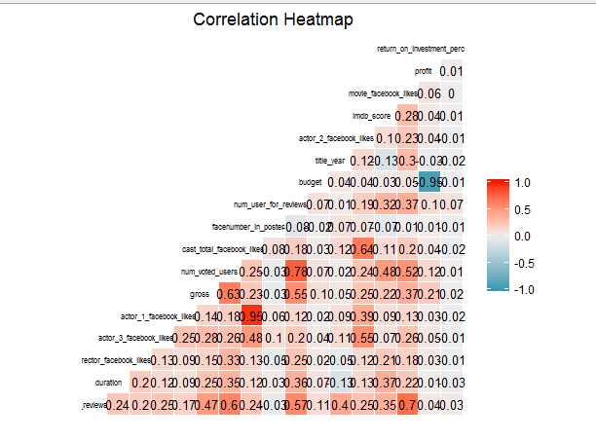
Correlation

Slide 36
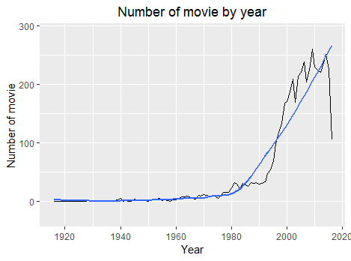
Number of movies by year

Slide 37
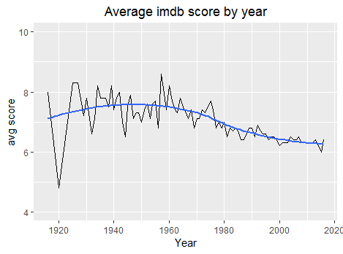
Average IMDB score by year

Slide 38
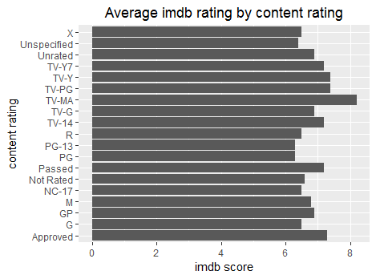
Average IMDB rating by content rating

Slide 39
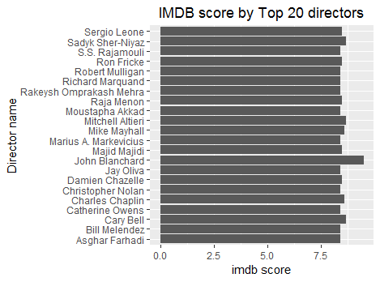
IMDB score by top 20 directors

Slide 40
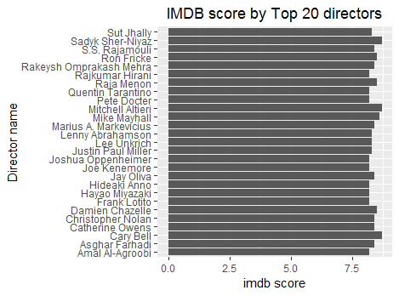
IMDB score by top 20 directors after 2000

Slide 41
Top 3 highest gross movies of each year from 2010-2016
movie_title | director_name | actor_1_name | gross
Toy Story 3Â | Lee Unkrich | Tom Hanks | 414984497
Alice in WonderlandÂ | Tim Burton | Johnny Depp | 334185206
Alice in WonderlandÂ | Tim Burton | Johnny Depp | 334185206
2010
movie_title | director_name | actor_1_name | gross
Transformers: Dark of the MoonÂ | Michael Bay | Glenn Morshower | 352358779
The Hangover Part IIÂ | Todd Phillips | Bradley Cooper | 254455986
Pirates of the Caribbean: On Stranger TidesÂ | Rob Marshall | Johnny Depp | 241063875
2011

Slide 42
Top 3 highest gross movies of each year from 2010-2016 (contd.)
movie_title | director_name | actor_1_name | gross
The AvengersÂ | Joss Whedon | Chris Hemsworth | 623279547
The AvengersÂ | Joss Whedon | Chris Hemsworth | 623279547
The Dark Knight RisesÂ | Christopher Nolan | Tom Hardy | 448130642
2012
movie_title | director_name | actor_1_name | gross
The AvengersÂ | Joss Whedon | Chris Hemsworth | 623279547
The AvengersÂ | Joss Whedon | Chris Hemsworth | 623279547
The Dark Knight RisesÂ | Christopher Nolan | Tom Hardy | 448130642
2013

Slide 43
Top 3 highest gross movies of each year from 2010-2016 (contd.)
movie_title | director_name | actor_1_name | gross
American SniperÂ | Clint Eastwood | Bradley Cooper | 350123553
The Hunger Games: Mockingjay - Part 1Â | Francis Lawrence | Jennifer Lawrence | 337103873
Guardians of the GalaxyÂ | James Gunn | Bradley Cooper | 333130696
2014
movie_title | director_name | actor_1_name | gross
Jurassic WorldÂ | Colin Trevorrow | Bryce Dallas Howard | 652177271
Avengers: Age of UltronÂ | Joss Whedon | Chris Hemsworth | 458991599
Inside OutÂ | Pete Docter | Amy Poehler | 356454367
2015

Slide 44
Top 3 highest gross movies of each year from 2010-2016 (contd.)
movie_title | director_name | actor_1_name | gross
Captain America: Civil WarÂ | Anthony Russo | Robert Downey Jr. | 407197282
DeadpoolÂ | Tim Miller | Ryan Reynolds | 363024263
The Jungle BookÂ | Jon Favreau | Scarlett Johansson | 362645141
The Jungle BookÂ | Jon Favreau | Scarlett Johansson | 362645141
2016

Slide 45
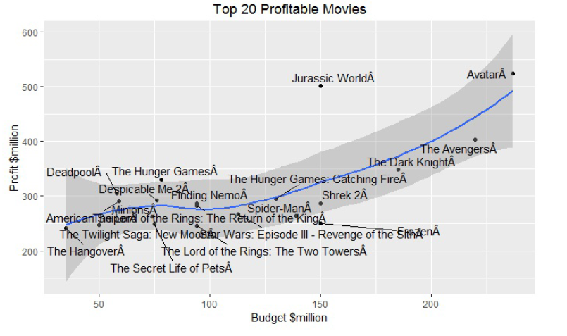
Top 20 profitable movies

Slide 46
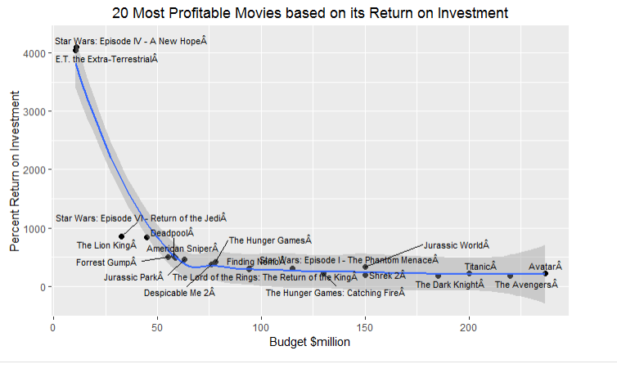
Top 20 profitable movies based on Return on Investment

Slide 47
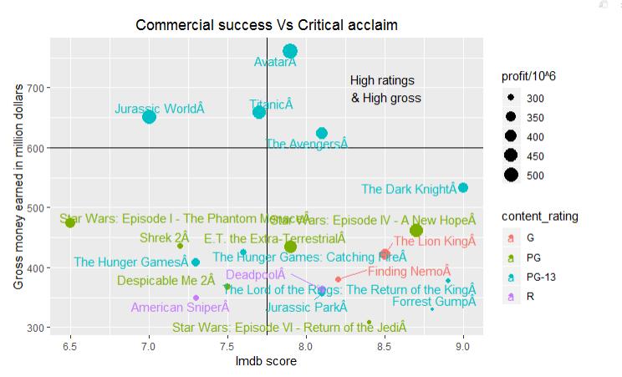
Commercial success vs critical acclaim

Slide 48

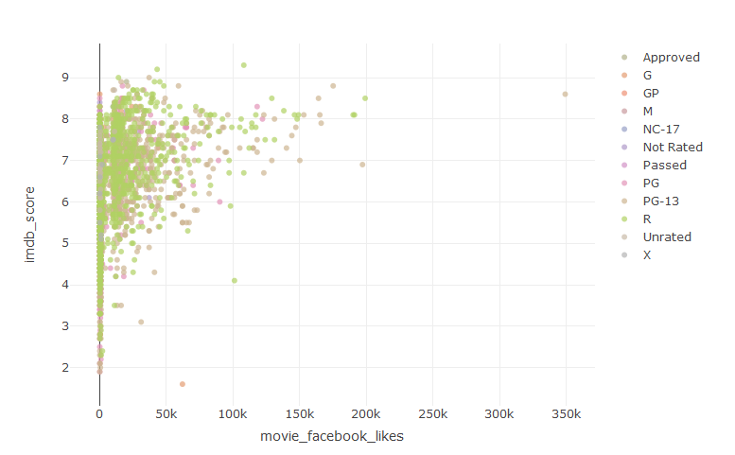
IMDB score vs Facebook likes

Slide 49
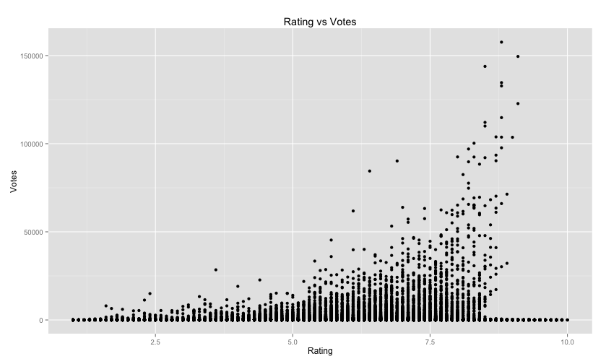
IMDB rating vs number of votes

Slide 50
Data Modeling
Goals and Objectives:
We will understand what are the important factors that make a movie more successful than others in other words, get higher IMDB score. We also want to show the results of this analysis in an intuitive way by visualizing outcome using ggplot2 in R.
In this project, we take “imdb_score” as response variable and focus on operating predictions by analyzing the rest of variables in the IMDB 5024 movie data.
The results can help film production companies to understand the secret of producing a successful movie.

Slide 51
Data Modeling
The model : Multiple Linear Regressions Analysis
The Multiple linear regression model in this project will be used mainly for 3 purposes
It will help us identify the strength of the effect that the independent variables(Gross Earnings, Budget, Language etc.) have on the overall iMDb rating.
Second, it will help us to forecast effects or impacts of changes. That is, how much will the iMDb rating change when we change the independent variables. For instance, a higher gross earnings for a movie should result in a higher iMDb rating for that movie according to basic economic theory.
Third, it will help us predict the trends and values. This can be used to answer questions such as, “What would be the iMDb rating for a movie with Gross Earnings of $400,000 and a budget of $200,000?”

Slide 52
Data Modeling
The model – Multiple Linear Regressions Analysis
Dependent variable – imdb_score
Independent variable - director_facebook_likes, actor_1_facebook_likes, actor_2_facebook_likes, actor_3_facebook_likes, num_voted_users, cast_total_facebook_likes, num_user_for_reviews,budget,duration, num_critic_for_reviews & movie_facebook_likes

Slide 53
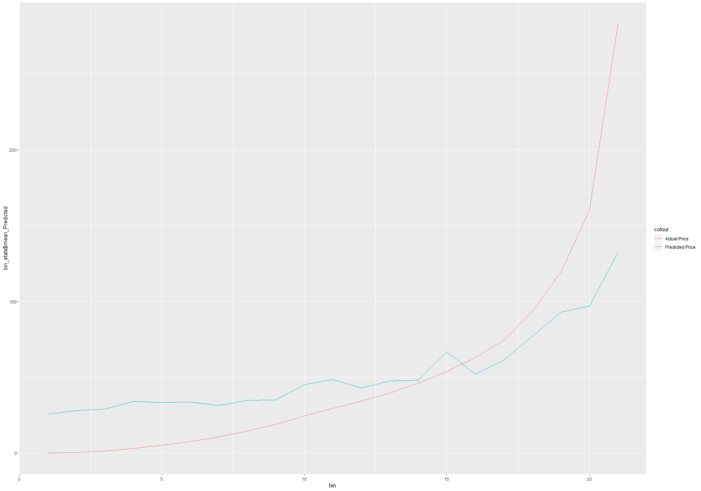
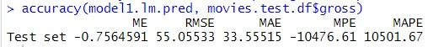
Build the model: 1st variable model
1st variable model
1st variable model_accuracy
1st variable model_accuracy plot

Slide 54
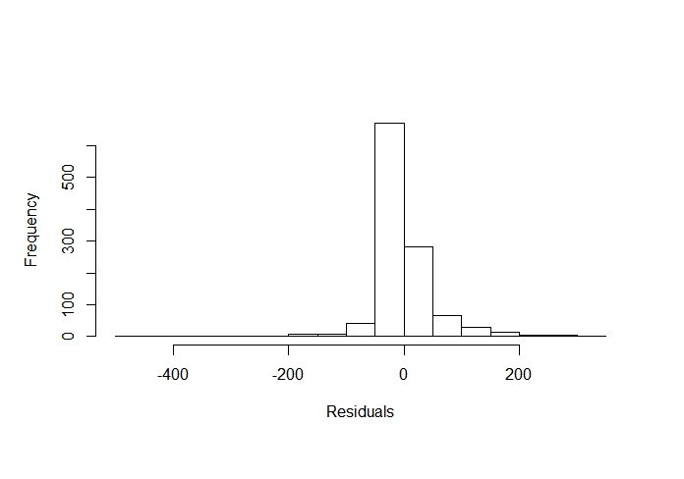
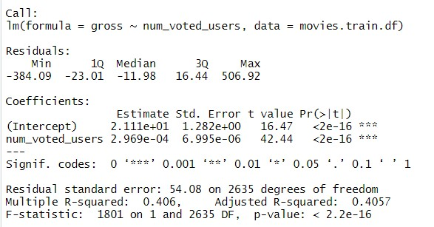
1st variable model (contd.)
1st variable model_residual plot
1st variable model_summary

Slide 55
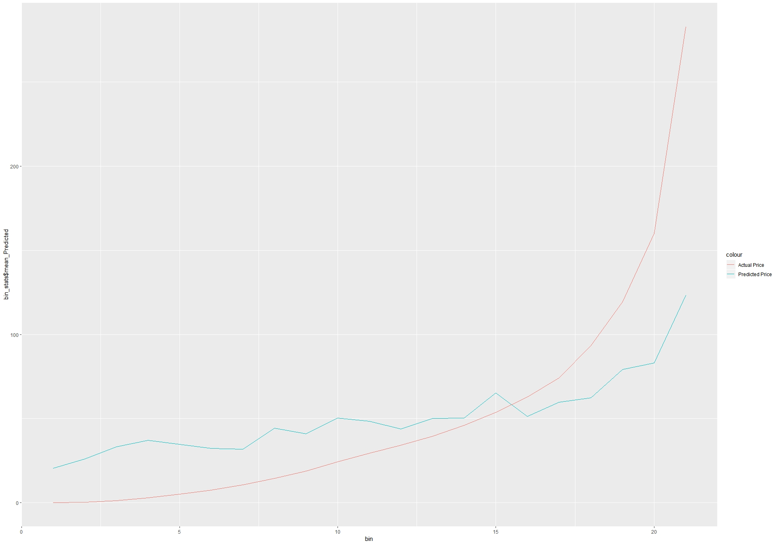
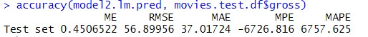
2nd variable model
2nd variable model
2nd variable model_accuracy
2nd variable model_accuracy plot

Slide 56
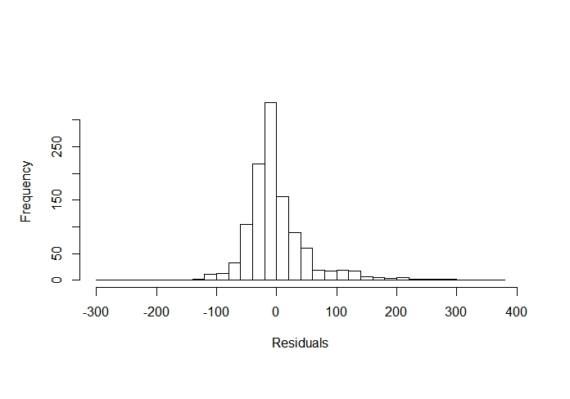
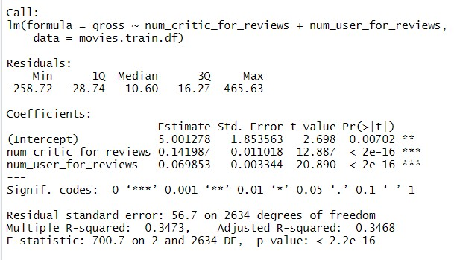
2nd variable model (contd.)
2nd variable model_residuals plot
2nd variable model_summary

Slide 57
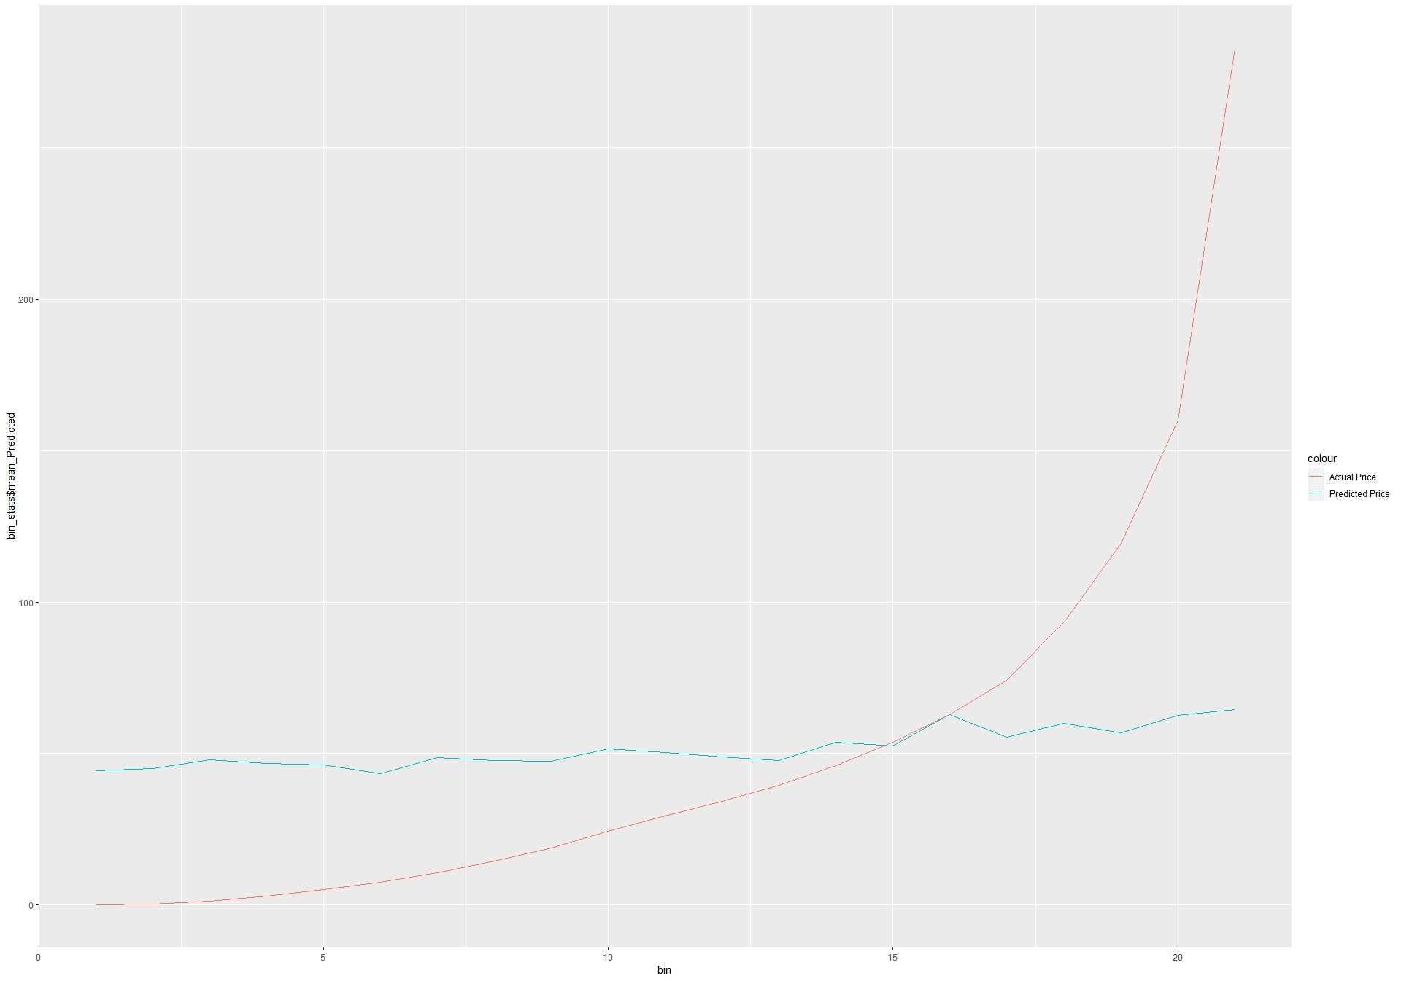
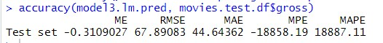
3rd variable model
3rd variable model
3rd variable model_accuracy
3rd variable model_accuracy plot

Slide 58
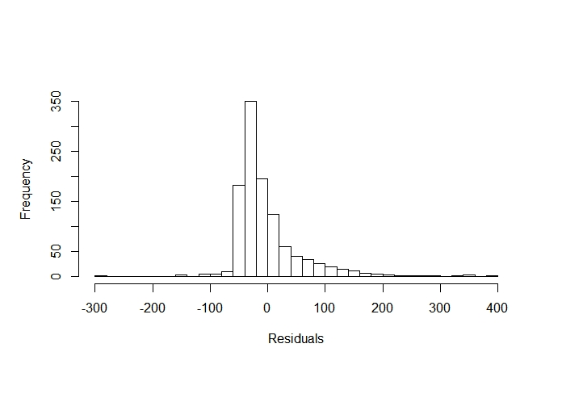
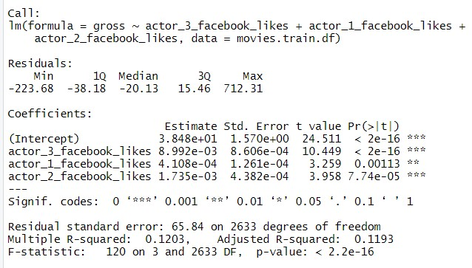
3rd variable model (contd.)
3rd variable model_residuals plot
3rd variable model_summary

Slide 59
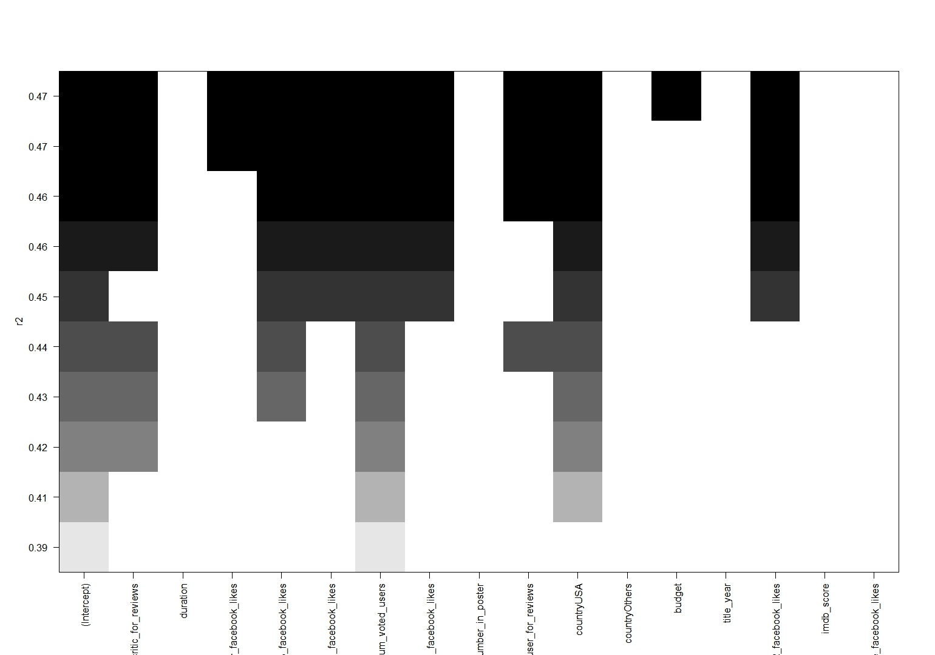
Regression Subsets

Slide 60
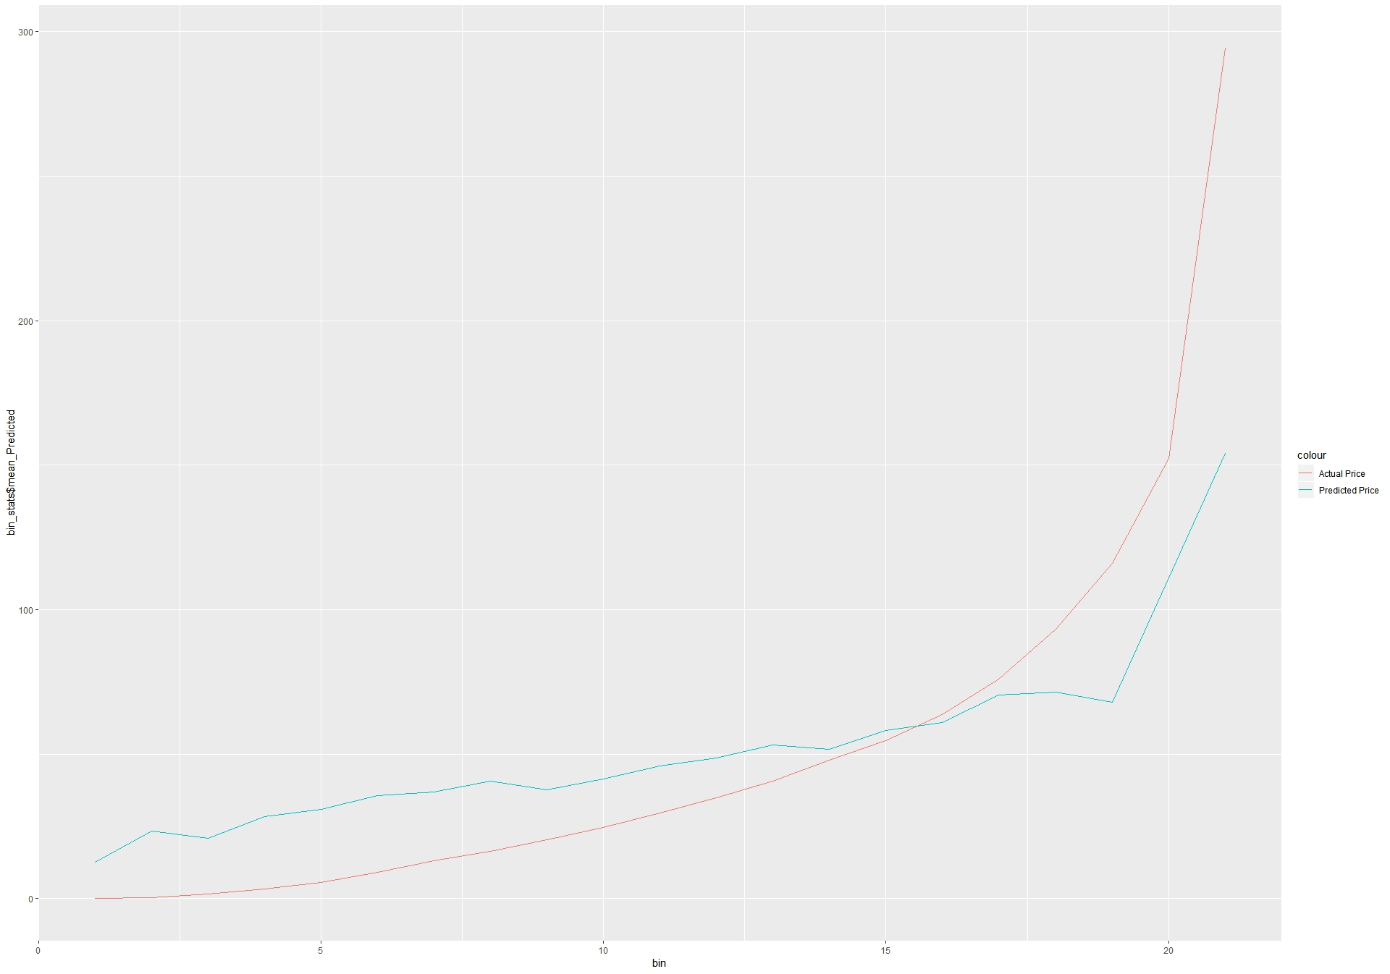
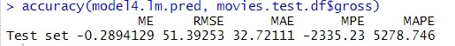
Best variable model
best variables model
best variables model_accuracy
best variables model_accuracy plot

Slide 61
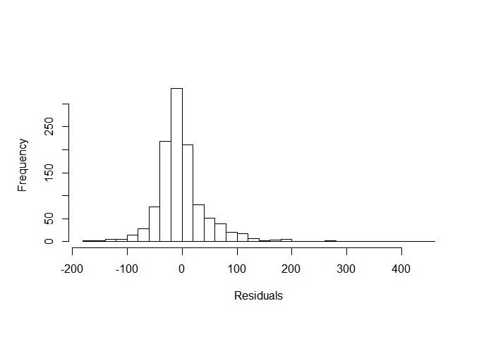
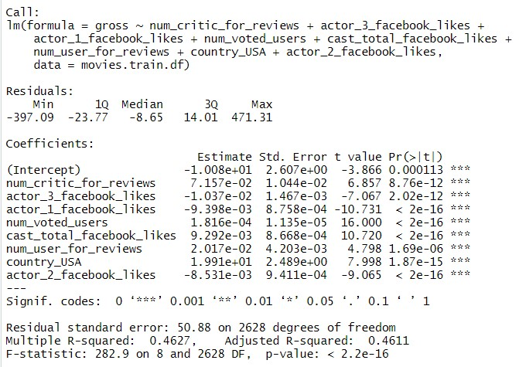
Best variable model (contd.)
best variables model_residuals plot
best variables model_summary

Slide 62
Recommendations
Our target form Warner Bros. can use the predicted IMDb score to understand which casting combination of actors will help the film succeed financially.
Warner Bros. can benefit from the analysis of the genres of movies that have done well in past.
Warner Bros. can benefit from the analysis of directors and their respective budgets to decide what range of budget is beneficial for each director.

